Slide 1
TABLE TAG
Tables represent tabular data
A table consists of one or several rows
Each row has one or more columns
The HTML tables allow web authors to arrange data like text, images, links, other tables, etc. into rows and columns of cells.
The <table> tag defines an HTML table.
Each table row is defined with a <tr> tag. Each table header is defined with a <th> tag. Each table data/cell is defined with a <td> tag.
By default, the text in <th> elements are bold and centered.
By default, the text in <td> elements are regular and left-aligned.

Slide 2
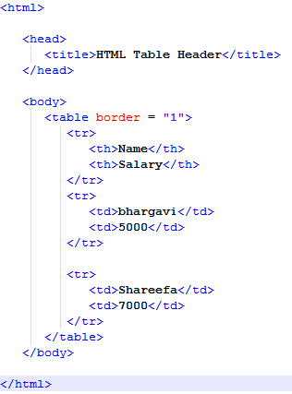
EXAMPLE

Slide 3
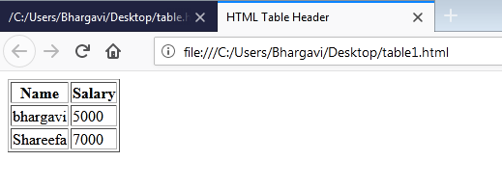
cont..

Slide 4
Cellspacing And Cellpadding Attributes
There are two attributes called cellpadding and cellspacing which you will use to adjust the white space in your table cells.
The cellspacing attribute defines space between table cells
while cellpadding represents the distance between cell borders and the content within a cell.

Slide 5
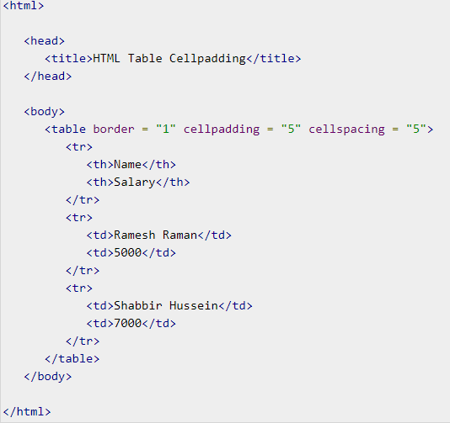
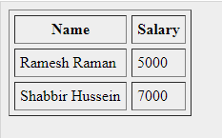

Slide 6
Colspan And Rowspan Attributes
You will use colspan attribute if you want to merge two or more columns into a single column.
Similar way you will use rowspan if you want to merge two or more rows.

Slide 7
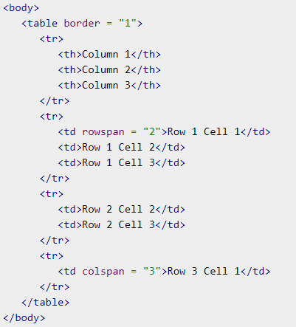
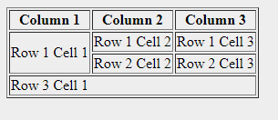

Slide 8
Tables Backgrounds
You can set table background using one of the following two ways −
bgcolor attribute − You can set background color for whole table or just for one cell.
background attribute − You can set background image for whole table or just for one cell.
You can also set border color also using bordercolor attribute

Slide 9
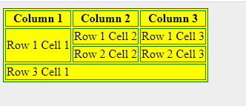

Slide 10
FORMS
<form> tag is used for creating a form for user input
The HTML <form> tag is used to create an HTML form and it has following syntax:
<form action="Script URL" method="GET|POST">
form elements like input, text area etc.
</form>
Attribute | Description
action | url of Backend script ready to process your passed data.
method | Method to be used to send data. The most frequently used are GET and POST methods.

Slide 11

HTML Form Controls or Elements
There are different types of form controls that you can use to collect data using HTML form
Text Input Controls
Checkboxes Controls
Radio Box Controls
Select Box Controls
File Select boxes
Submit and Reset Button

Slide 12
Text Input Controls
Text Field
Password field
Text Area
Text Field:
This is used for items that require only one line of user input, such as search boxes or names.
They are created using HTML <input> tag.
Syntax:
<input type="text" name="first_name" value=“initial value”/>

Slide 13
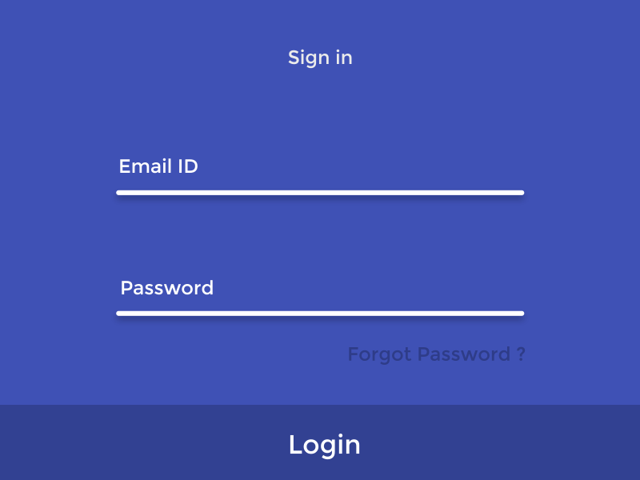
Cont …
Password field:
This is also a single-line text input but it masks the character as soon as a user enters it.
They are also created using HTML <input> tag but type attribute is set to password.
Syntax:
<input type=“password" name=“password" />
Textarea:
This is used when the user is required to give details that may be longer than a single sentence.
Multi-line input controls are created using HTML <textarea> tag.
<textarea rows="5" cols="50" name="description">

Slide 14
Example
<html>
<body bgcolor=“pink">
<form >
User ID : <input type="text" name="user_id" />
<br>
Password: <input type="password" name="password" /><br>
Description : <br>
<textarea rows="5" cols="50" name="description">
Enter description here...
</textarea>
</form>
</body>
</html>

Slide 15
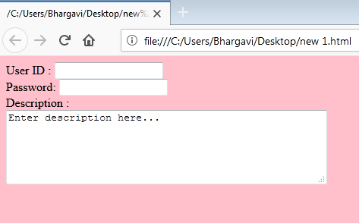

Slide 16
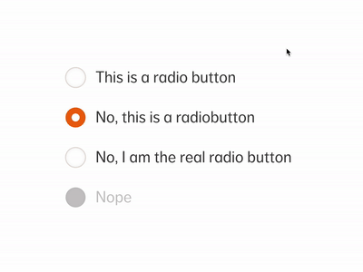
Radio Buttons
Radio buttons are used when out of many options, just one option is required to be selected.
They are also created using HTML <input> tag but type attribute is set to radio.
Syntax:<input type="radio" name=“name" value=“value">
Attribute | Description
type | Indicates the type of input control and for radio input control it will be set to radio.
name | Used to give a name to the control which is sent to the server to be recognized and get the value.
value | The value that will be used if the radio box is selected.
checked | Set to checked if you want to select it by default.

Slide 17
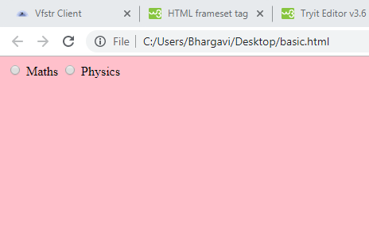
<html>
<body bgcolor="pink">
<form>
<input type="radio" name="subject" value="maths"> Maths
<input type="radio" name="subject" value="physics"> Physics
</form>
</body>
</html>

Slide 18
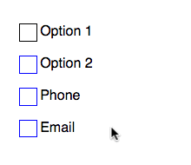
Checkboxes
Checkboxes are used when more than one option is required to be selected.
They are also created using HTML <input> tag but type attribute is set to checkbox
Syntax:
<input type="checkbox" name=“name" value="on">
Attribute | Description
type | Indicates the type of input control and for checkbox input control it will be set to checkbox.
name | Used to give a name to the control which is sent to the server to be recognized and get the value.
value | The value that will be used if the checkbox is selected.
checked | Set to checked if you want to select it by default.

Slide 19
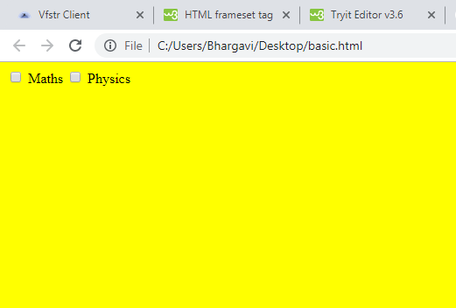
Example
<html>
<body bgcolor="blue">
<form>
<input type="checkbox" name="maths" value="on"> Maths
<input type="checkbox" name="physics" value="on"> Physics
</form>
</body>
</html>

Slide 20
Select Box
A select box, also called drop down box which provides option to list down various options in the form of drop down list, from where a user can select one or more options.
<select name="dropdown">
<option value="Maths" selected>Maths</option>
<option value="Physics">Physics</option>
</select>

Slide 21

Example
<select name=”selColor”>
<option selected=”selected” value=”“>Select color</option>
<option value=”red”>Red</option>
<option value=”green” selected>Green</option>
<option value=”blue”>Blue</option>
</select>

Slide 22
Output

Slide 23
File Select Boxes
If you want to allow a user to upload a file to your web site, you will need to use a file upload box, also known as a file select box.
This is also created using the <input> element but type attribute is set to file.
Syntax :<input type="file" name="fileupload" accept="image/*" />
Attribute | Description
name | Used to give a name to the control which is sent to the server to be recognized and get the value.
accept | Specifies the types of files that the server accepts.

Slide 24
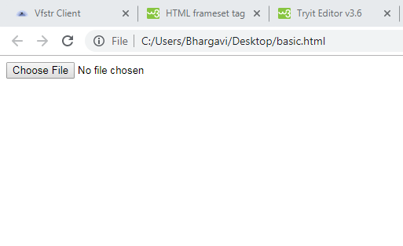
EXAMPLE
<html><body>
<form>
<input type="file" name="fileupload" accept="image/*" />
</form>
</body>
</html>

Slide 25
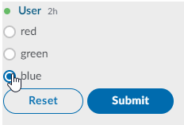
Button Controls
There are various ways in HTML to create clickable buttons. You can also create a clickable button using <input> tag by setting its type attribute to button.
The type attribute can take the following values:
Type | Description
submit | This creates a button that automatically submits a form.
reset | This creates a button that automatically resets form controls to their initial values.
image | This creates a clickable button but we can use an image as background of the button.

Slide 26
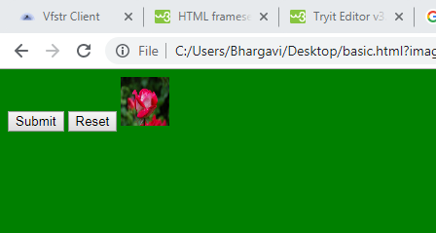
<html>
<body bgcolor="green">
<form>
<input type="submit" name="submit" value="Submit" />
<input type="reset" name="reset" value="Reset" />
<input type="image" name="imagebutton" src=“rose.jpg" />
</form>
</body>
</html>

Slide 27
Fieldsets & Labels
Fieldsets are used to enclose a group of related form fields:
The <legend> is used to set the fieldset's title.
<fieldset>
<legend>Title</legend>
</fieldset>
Form labels are used to associate an text to a form field
<label>First Name</label>

Slide 28
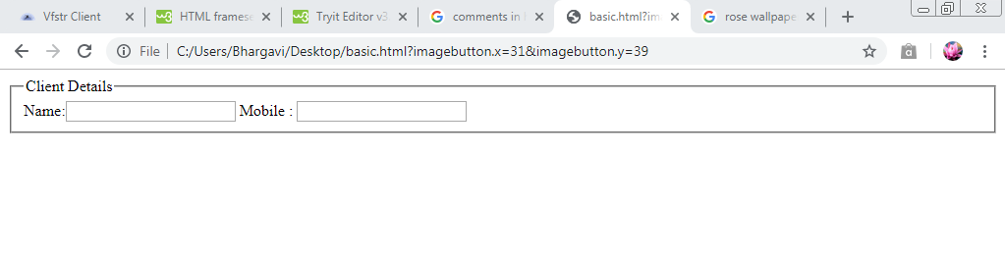
<html>
<form method="post" action="form.aspx">
<fieldset>
<legend>Client Details</legend>
<Label>Name:</label><input type="text" id="Name" />
<Label>Mobile :</label> <input type="text" id="Phone" />
</fieldset>
</html>

Slide 29
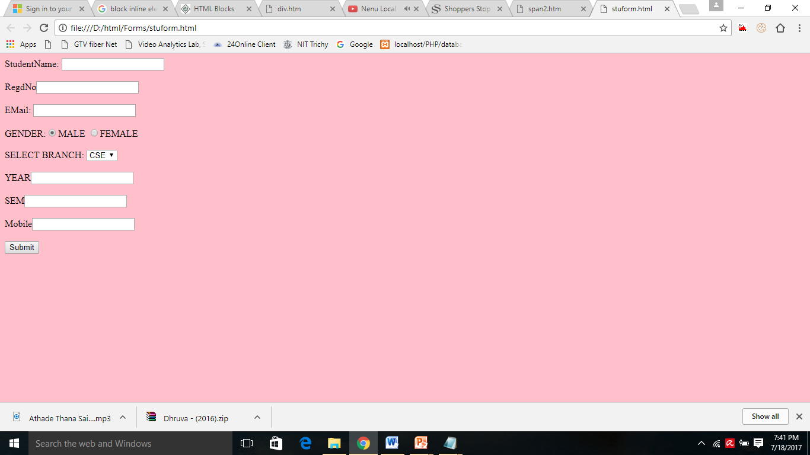


Slide 30
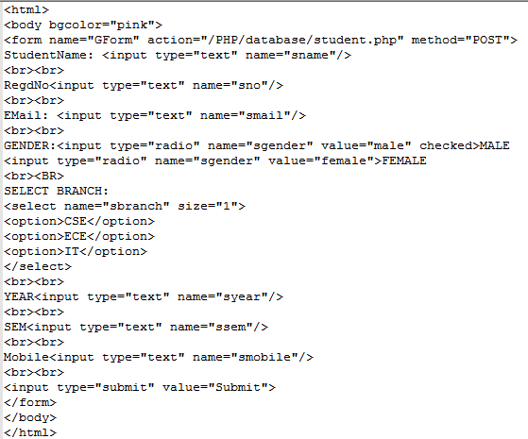

Slide 31

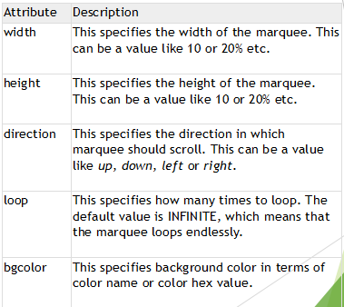
Marquee Tag
An HTML marquee is a scrolling piece of text displayed either horizontally across or vertically down your webpage depending on the settings.
This is created by using HTML <marquee> tag.
<marquee attribute="value"...> One or more lines or text message or image </marquee>

Slide 32
Block And Inline Elements
Block Elements:
Block elements add a line break before and after them
<p>, <h1>, <h2>, <h3>, <h4>, <h5>, <h6>, <ul>, <ol>, <dl>, <pre>, <hr />, <div> .
They all start on their own new line, and anything that follows them appears on its own new line.
Div tag
<div> creates logical divisions within a page,Block style element,Used with CSS
This is the very important block level tag which plays a big role in grouping various other HTML tags and applying CSS on group of elements.

Slide 33
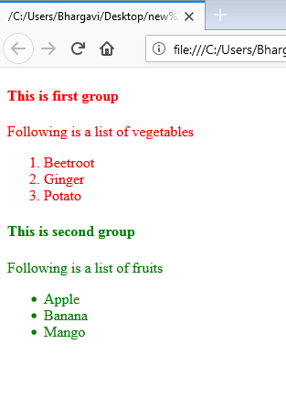
<html>
<body>
<div style="color:red">
<h4>This is first group</h4>
<p>Following is a list of vegetables</p>
<ol>
<li>Beetroot</li>
<li>Ginger</li>
<li>Potato</li>
</ol>
</div>
<div style="color:green">
<h4>This is second group</h4>
<p>Following is a list of fruits</p>
<ul>
<li>Apple</li>
<li>Banana</li>
<li>Mango</li>
</ul>
</div></body></html>

Slide 34
Inline Elements
Inline elements don’t break the text before and after them
Inline elements, on the other hand, can appear within sentences and do not have to appear on a new line of their own.
The <b>, <i>, <u>, <strong>, <sup>, <sub>, <li>, <del>,<span>.

